Slide 1



Project Introduction
The E-Commerce Backend System is built using FastAPI to support a modern, secure, and scalable REST API for an online shopping platform. It provides role-based access control for Admins and Users, supports product management, cart functionality, order processing, and secure authentication with logging and error handling.

Slide 2

Technology Stack
Here's the technologies used in the E-Commerce Backend System:
Layer
Technology Used
Backend
Python 3.12 + FastAPI
ORM
SQLAlchemy
Database
PostgreSQL
Auth
JWT (JSON Web Tokens)
Logging
Python’s logging module
Emailing
SMTP with FastAPI BackgroundTasks
Tools
Uvicorn, Pydantic, Postman

Slide 3
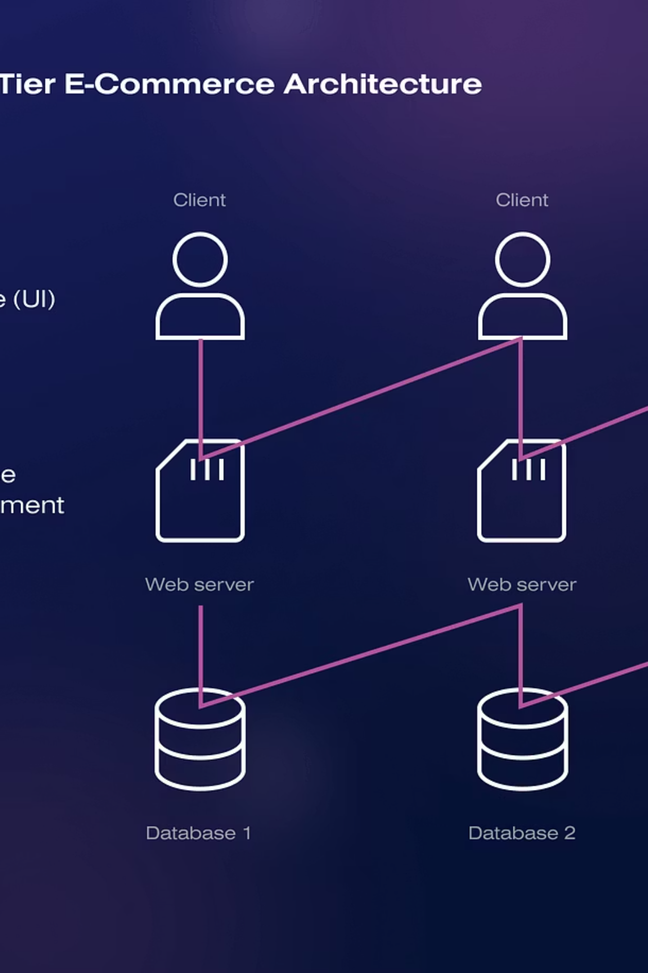

System Architecture
The system architecture is designed for clarity and efficiency:
[FastAPI Routers] --> [Service Logic + DB Access] --> [PostgreSQL DB] | [JWT Auth Middleware] | v [Logging + Errors]

Slide 4



User Roles
User
Admin
Register/Login
Create, Update, Delete Products
View/Search products
View all products
Add to cart
Manage categories
Checkout
View order history

Slide 5
Features by Module
Auth - User Authentication & Role Management
Products - Product Management
Cart - Shopping Cart
Add/update/remove items from cart
Signup / Login using JWT
CRUD operations (Admin only)
Prevent adding more items than stock
Password hashing (bcrypt)
Public listing, pagination, filtering
Auto-remove deleted products
Role assignment during registration (admin/user)
Product search
View full cart with product names
Deleted products are removed from:
Password reset using email with token
Listings
Logging of login/logout and signup
Carts (with notification)
Checkout - Order Creation
Orders - Order Management
Convert cart items to orders
View order history (user only)
Dummy payment method: Cash on Delivery / Online
View order details
Deduct stock after successful order
Fetch product names even if product is deleted
Status: "paid" or "pending"
Log each checkout

Slide 6

Error Handling
All errors are returned in this format:
{ "error": true, "message": "Description of the error", "code": 400 }
Global handlers:
HTTP Exceptions
Unhandled Exceptions (with logging)

Slide 7

Logging
Using Python’s logging module, the following information is logged:
Event Type
Logged Information
API Access
IP, Method, Path
Auth Events
Signin, Signup attempts
Checkout
Order placed, stock deducted
Errors/Exceptions
Stack, route, user if available
Product Deletion
If product was deleted from cart too

Slide 8
API Testing (Postman)
Auth API
POST /auth/signup - Register a new user
POST /auth/signin - Login and get access token
POST /auth/forgot-password - Request password reset token
POST /auth/reset-password - Reset password using token
Products API
Public or Users
GET /products - List products with filters, pagination
GET /products/search - Search products by name
GET /products/{id} - Get product details
Admin Only
POST /admin/products - Add new product
GET /admin/products - List all products (admin view)
GET /admin/products/{id} - Get single product (admin view)
PUT /admin/products/{id} - Update product
DELETE /admin/products/{id} - Delete product and from all carts
Cart API
POST /cart - Add item to cart
GET /cart - View current cart
PUT /cart/{product_id} - Update quantity of item in cart
DELETE /cart/{product_id} - Remove item from cart
Checkout API
POST /checkout - Place order with payment method
Orders API
GET /orders - View order history of current user
GET /orders/{id} - View details of specific order
ECommerce Collection - https://sarthak-5690584.postman.co/workspace/Sarthak's-Workspace~4441b7fc-4b4f-4f5a-8632-423fd5a9953c/collection/45892851-f2e558e9-c632-4632-9c93-a212a53d5968?action=share&creator=45892851

Slide 9
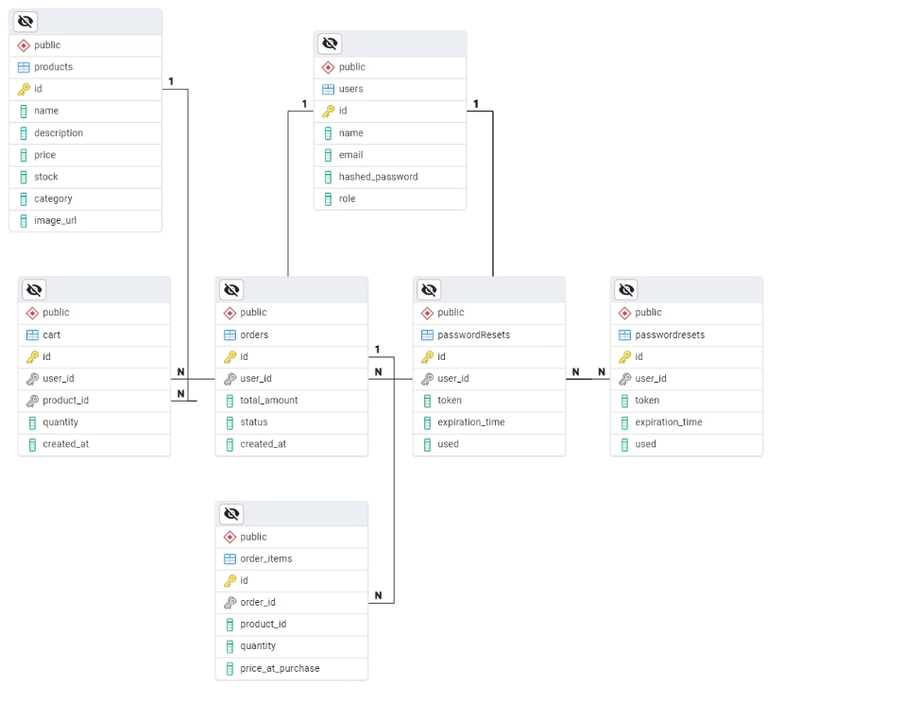



ER-Diagram
ER diagram models the database of an e-commerce platform, covering users, products, carts, orders, and password management.
Key Tables:
Users – Stores user info and roles
Products – Product details like price, stock
Cart – Temporary storage before purchase
Orders & Order_Items – Track confirmed purchases
PasswordResets – Handles secure password recovery
Relationships:
One user → many carts, orders, password resets
One order → many order items
One product → many cart/order items

Slide 10

Conclusion
I have successfully developed and tested a robust e-commerce backend system using FastAPI. It includes role-based access control, secure user authentication, complete shopping workflow, and features like password reset via token and email. The system handles product deletion gracefully, including messaging for deleted items, and ensures comprehensive error handling with proper logging. All endpoints were tested using Postman, responding with appropriate status codes and validated data. The API is secure, modular, scalable, and delivers a seamless user experience — ready for real-world deployment.

